Slide 1

Technical Leadership Initiatives
Abhijeet Mukkawar

Slide 2
Braingile - Unlock Developer's Feature level confidence - <Feature Name> One initiative to improve developer velocity
Background for Braingile (Brain + Agile)
While working on feature, tech/dev team must take consideration of bunch of things like for example ecosystem consultations, interface consideration, API, API enablement, documentation, architecture, translations, virtualization, figma links, UI related changes and many mores. Observations were like team used to miss out things in this process and at the time of sprint execution, we witnessed many impediments and that delayed the delivery.
An idea clicked to address this problem, where i produced checklist gamification like at the start of project, all team sits together and perform brainstorming together and identify all the possible connecting dots. And at each stage of the development, team members who identifies things earlier, will get credits. At the end, we will decide champion team and champion team members.
Benefits -
More we identify things earlier, likely to experience less impediments at the time of sprint execution.
As we get time and chance to resolve the issues way earlier, delivery would be indirectly smoother.
Gamification gives extra advantage to keep team engaged and add fun.
Expecting improvement in developer velocity by 30 to 40 percent or even more.
It will encourage people to participate and talk the feature level things at each stage of Agile project life cycle.
6. It's kind of creating competitive environment without compromising with the spirit of the team and improve the project
efficiency overall.
Refer attachment - Braingile- Unlock Developer's Feature level confidence

Slide 3


Accelerating the Fresher’s Mentorship Program
Idea of having quiz is not to judge mentee like how they are, but to understand
where they are, so mentors can fill their knowledge gap accordingly and empower them
Mentee
Mentors
Focus Quiz #1
Basic Platform Technical
A] Our Mentors have carefully crafted a quiz (with 30-40 questions) on basic technical
iOS And Android - often, questions are from day-to-day dev tasks or story development.
B] We administered an hour-long test to assess their current knowledge.
C] Post test, a one-on-one mentoring session was organized to fill knowledge gaps..
A] We tried to focus on domain expertise here. We compiled a list of 30-40 questions that can
cover high-level and edge functionality.
B] We administered an hour-long test to assess their current knowledge.
C] Following the test, a one-on-one mentoring session was organized to fill knowledge gaps.
Focus Quiz #2
Domain
Focus Quiz #3
Process
A] We tried to focus on overall process (Change management, Agile and Tool).
We compiled a list of 30-40 questions that can cover end to end process understanding.
B] We administered an hour-long test to assess their current knowledge.
C] Following the test, a one-on-one mentoring session was organized to fill knowledge gaps.
A] We tried to focus on overall programming sense and day to day technical issues (Change
management and Tools). We compiled a list of 30-40 questions that can cover timebox
programming and basic troubleshooting.
B] We administered an hour-long test to assess their current knowledge.
C] Following the test, a one-on-one mentoring session was organized to fill knowledge gaps.
Focus Quiz #4
Programming & trouble-shooting

Slide 4
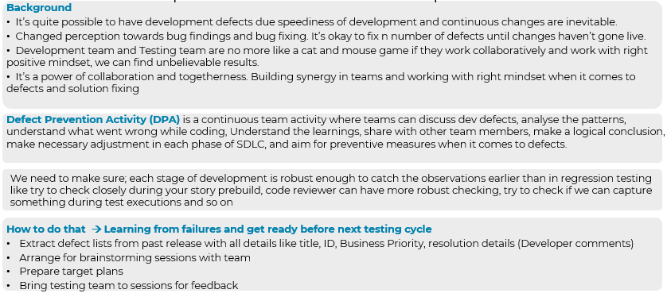
Continuous Improvement – Defect Control - Defect Prevention
One initiative to improve overall end customer experience

Slide 5
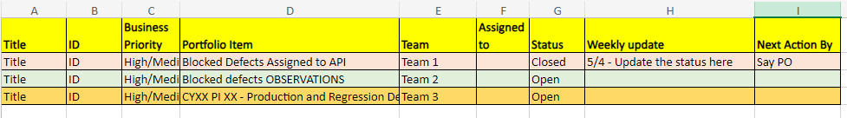
Long Pending blocked defects
One initiative - Managing defect tracking in different way
Aim is to action RIDA enabled defects like long pending defects
Benefits to Customer while improving customer experience
Tracking happens everyday post DSM and discuss overall progress with client on weekly basis

Slide 6
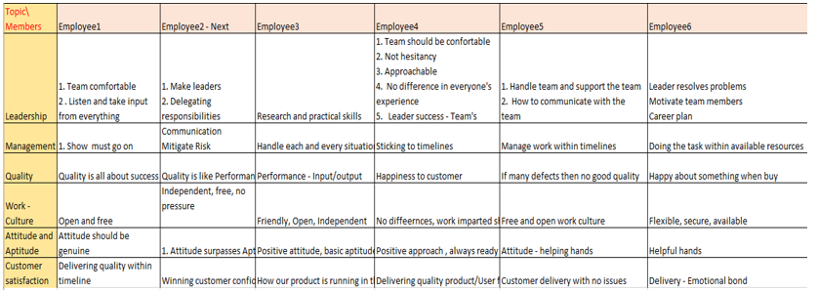
Scrum Event - Sprint Retrospective
One initiative – to make retro more meaningful
With this, we try to analyze team members perspectives when it comes client’s expectations and company objective. And, set the actions accordingly.

Slide 7
Innovation
One initiative – streamline innovation
How we approach to Innovation
Phases of Innovation
Past data Insights
Benefits to Customer and Eviden
Refer attachment – Project Innovation

Slide 8
Project Release Readiness
One initiative to track the feature progress at one place
One stop sheet – Monitoring features progress for all scrum teams
Meaningful insights for management
Keep everyone on same page
Avoid any slippage
Refer attachment – Feature_Project_Release Readiness

Slide 9
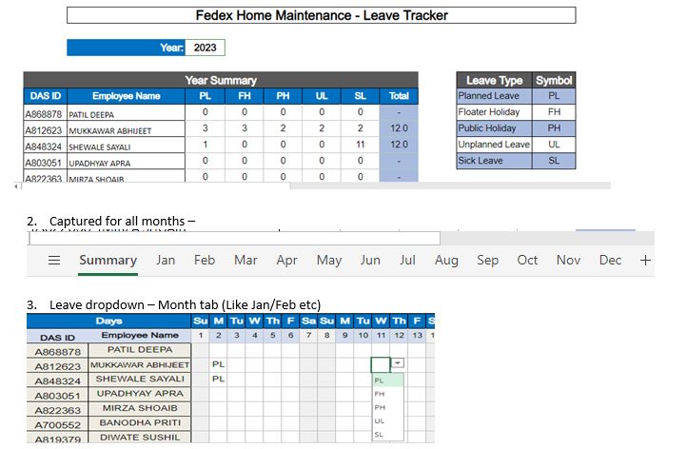
Team Level – Leave tracker/ Asset Management
Managing Employee leaves/Asset tracking in different way [Internal]

